Slide 1


Blood Bank Full Stack Project

Slide 2

INTRODUCTION
The Blood Bank Full Stack Project represents a sophisticated and comprehensive solution for managing blood donation activities, emphasizing efficiency, security, and scalability. This ambitious project integrates cutting-edge technologies to create a seamless and user-friendly experience for both donors and administrators within the blood bank system.
The primary objective of the Blood Bank Full Stack Project is to streamline the entire blood donation process, from user registration to inventory management, feedback collection, and data analysis. By leveraging the power of React, Redux, React Native, Node.js, and MongoDB, the project aims to provide a robust, responsive, and scalable solution for blood banks, hospitals, and organizations involved in the critical mission of saving lives through blood donations.

Slide 3

GOALS AND OBJECTIVES
User Authentication and Authorization
User Registration and Login
Secure password handling with bcrypt
Role-based access control
Email verification
Forms and Input Fields
Reusable Login Form
Creating a reusable React form component
Dynamic input fields based on user roles
Inventory Management
Model Creation for Inventory
Database operations for inventory management
Organization and user roles
Bootstrap integration and routing setup

Slide 4
GOALS AND OBJECTIVES
Notifications and Feedback
Notification System
Displaying custom error messages
Role-based forms for feedback submission
Dashboard and Data Analysis
Dashboard and Blue Record Management
Admin panel for data analysis
Role-based forms for data input
Integration and Deployment
Integration of React Application with Backend
CORS package for React.js and Node.js integration
Deploying a Web Application on Heroku

Slide 5
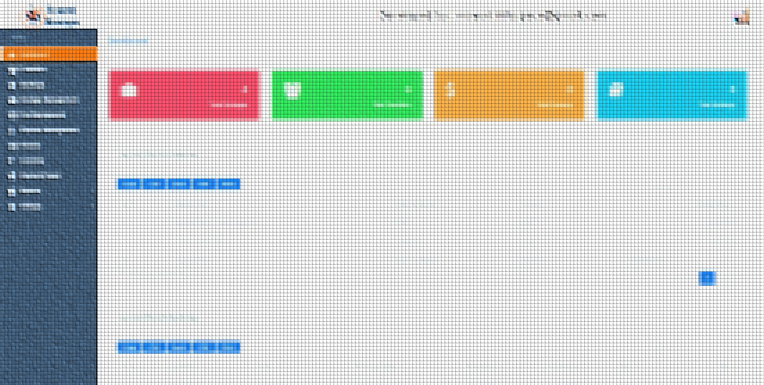
KEY FEATURES
The project focuses on creating a web application that facilitates the management of blood donations, connecting donors, hospitals, and administrators in a unified system. Adopting the MVC pattern for code organization, Node.js and Express.js for the server-side, React for the web frontend, and React Native for mobile development, the project achieves a scalable and modular architecture.

Slide 6
GOALS AND OBJECTIVE
User Authentication and Authorisation
State-of-the-Art State Management with Redux Toolkit
Environmental Variable Management
Password Hashing for Security
Integration and Deployment Best Practices
Nodemon for Development Efficiency

Slide 7
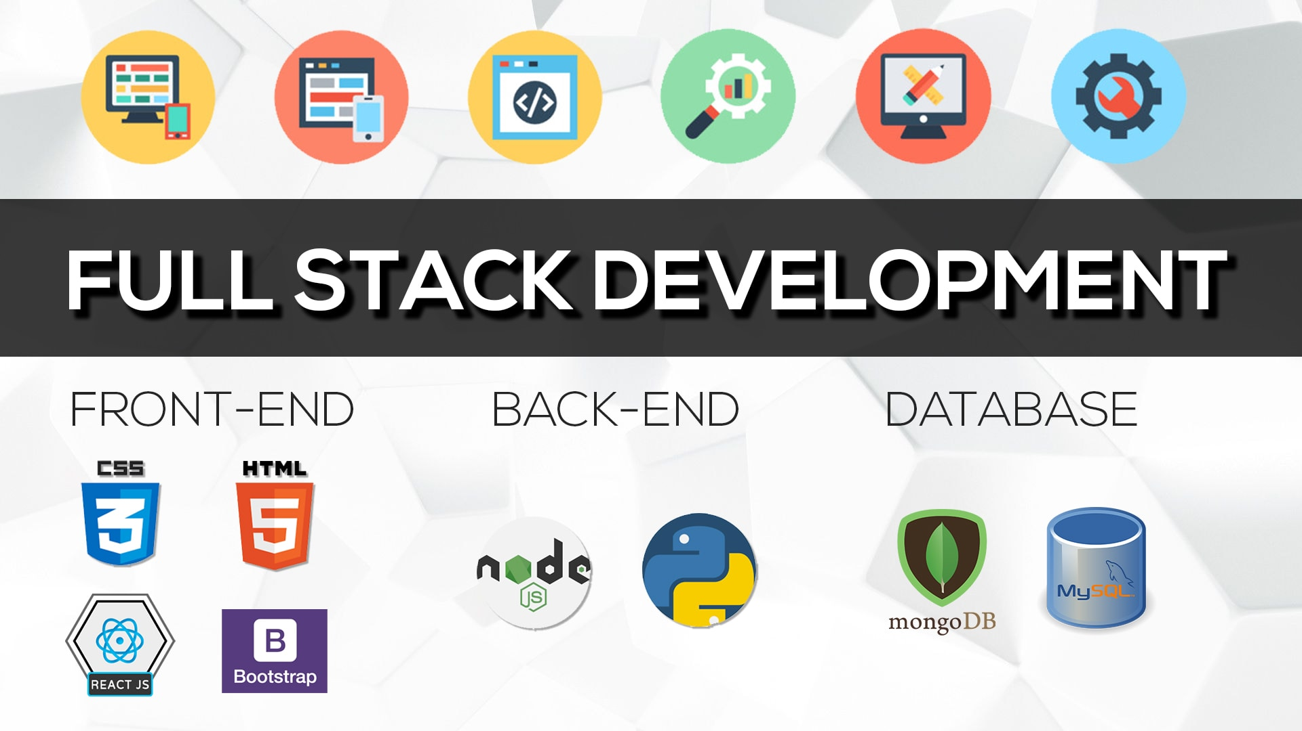
TECHNOLOGIES USED:
Frontend:
React
Redux
React Native
Bootstrap
Backend:
Node.js
Express.js
MongoDB
Deployment: Heroku

Slide 8
Potential Future Enhancements:
Real-Time Notifications
Geolocation Integration
Enhanced Reporting and Analytics
Mobile App Features
Gamification for Donor Engagement
Multi-Language Support
Enhanced Security Measures
Integration with Health Records
Feedback and Rating System

Slide 9

CONCLUSION
In conclusion, the Blood Bank Full Stack Project lays a solid foundation for efficient blood donation management. The incorporation of best practices, modern technologies, and a thoughtful architecture ensures a scalable, secure, and user-friendly application. With the potential for future enhancements and features, the project remains adaptable to the evolving needs of blood donation organizations, hospitals, and donors, contributing to the broader goal of saving lives through organized and technology-driven blood donation processes.

Slide 10

Submitted to: LAVISH SIR
By:Team Thinker_bots
Ankit Rai(2110992102)
Chiranshu(2110992197)
Manvi Gupta(2110992215)
Samarveer(2110992106)

